Slide 1
LinkedIn
Presented by The Incredibles.

Slide 2

Introduction.

Slide 3
What is LinkedIn?
This is a professional business networking platform that connects individuals, businesses and job seekers.
InMail messages
Advanced search filter
Profile views
Sales navigator

Slide 4

Importance of LinkedIn:
Made finding employees easier.
What was the process like before;

Slide 5

Importance of LinkedIn.
Made finding employees easier.
What is the process like now, with the implementation of LinkedIn in firms.

Slide 6
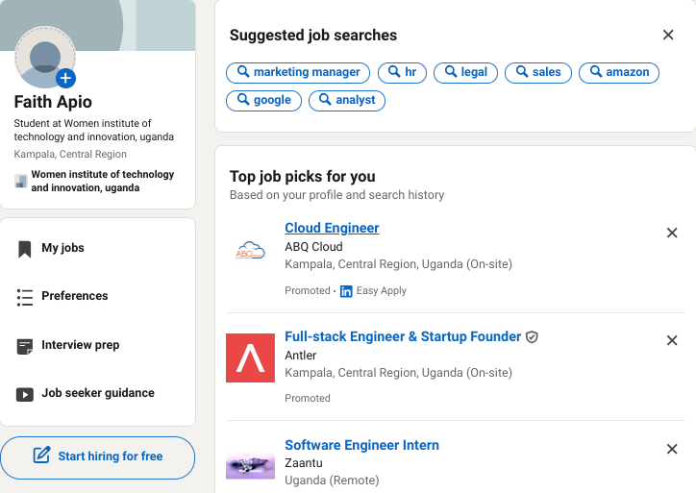
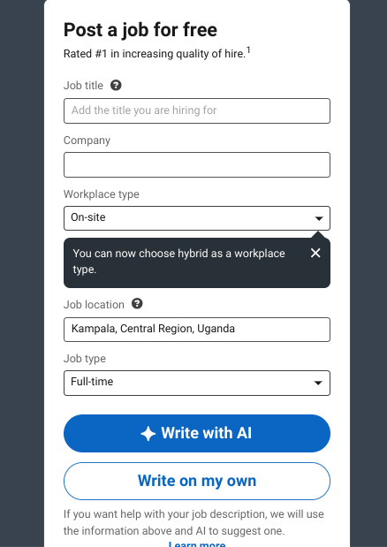
How to post a job opening on LinkedIn.

Slide 7

Job opening posted to LinkedIn from Uganda Unplugged.

Slide 8
Importance of LinkedIn:
2. Job seekers get information on available jobs in their related industry, and employers can vet potential employees.

Slide 9
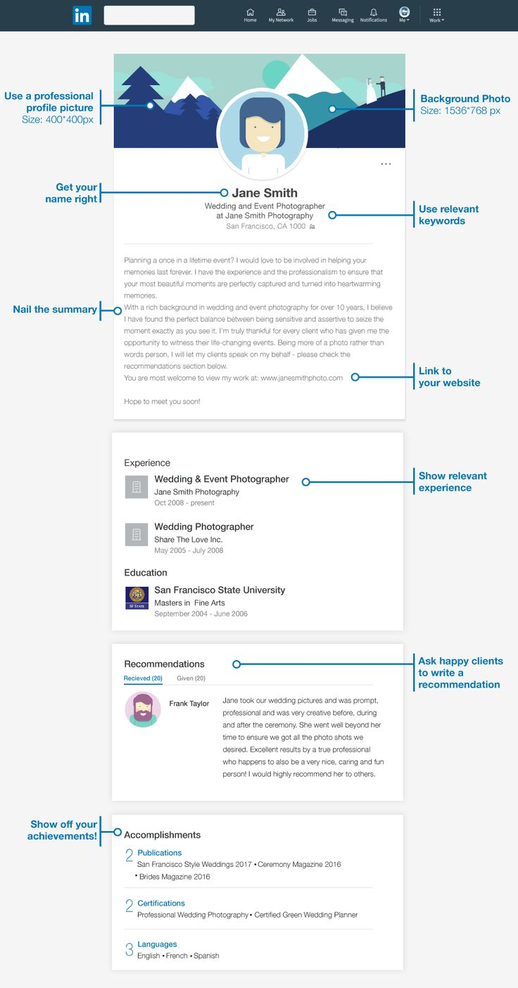
What a profile is made up of;

Slide 10
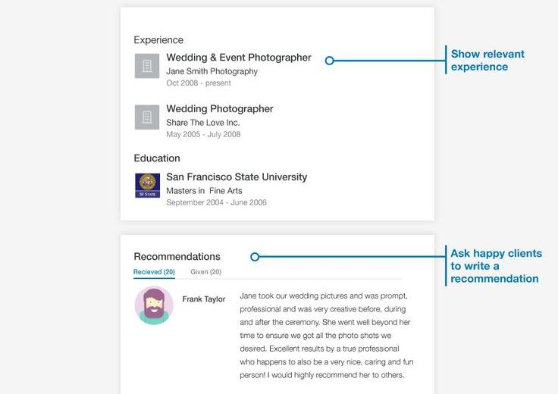
What is a profile made of;

Slide 11
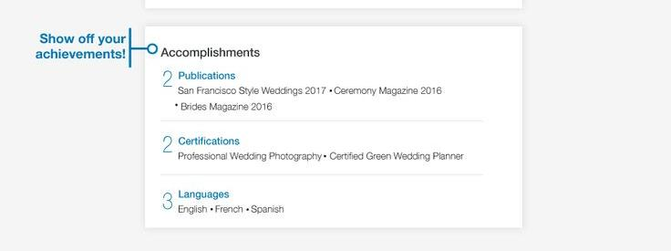
What a profile is made up of;

Slide 12
Building a strong profile:
Professional Photo
Compelling Headline
A clear headshot.
Showcase your expertise.
Detailed Summary
Highlight your skills.

Slide 13

Profile 1
Profiles speak where words don’t.

Slide 14

Profile 2

Slide 15
Later that day.

Slide 16

2 New Messages.
Email:
JOB OFFER!!! From Uganda Unplugged Organisation.
LinkedIn:
Two new profile views, today at 2 pm.

Slide 17
Importance of LinkedIn;
3. Networking, Learning and Content sharing.
1
Networking
Build professional connections.
2
LinkedIn Learning
Take courses to learn employable skills and marketing.
3
Content Sharing
Reach a wider audience.

Slide 18
Staying active on LinkedIn:
Regular Updates
Engage with Content
Share industry insights.
Like, comment, and share.
Expand Your Network
Connect with professionals.

Slide 19
Join LinkedIn

Slide 20
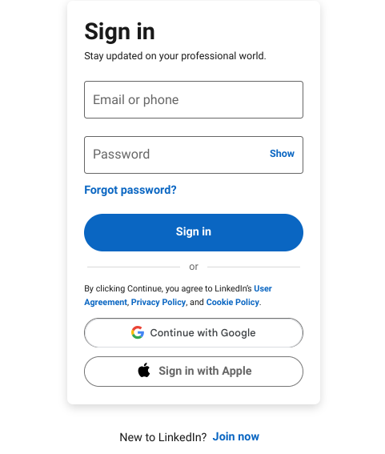

Slide 21
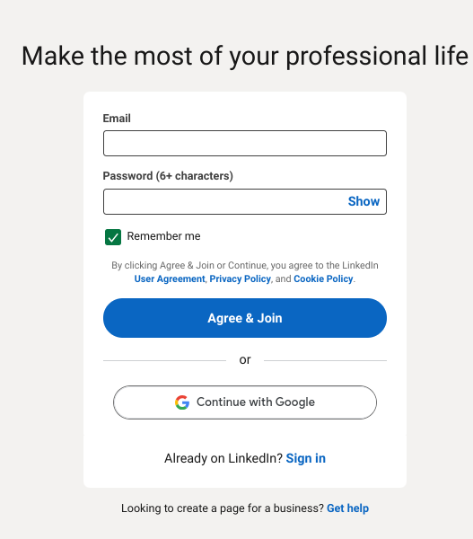

Slide 22
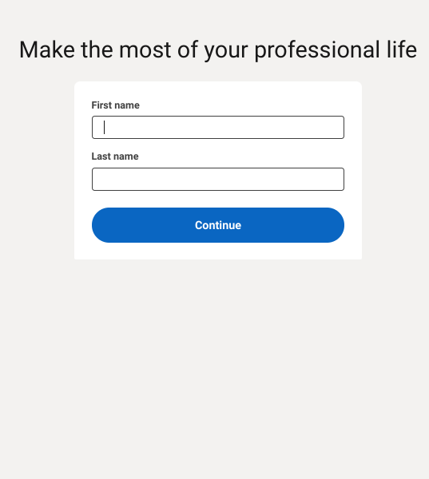

Slide 23
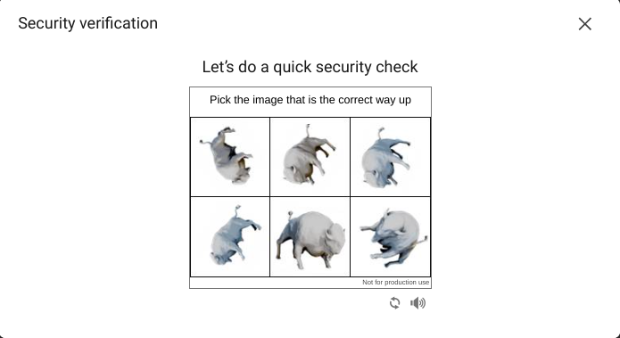

Slide 24
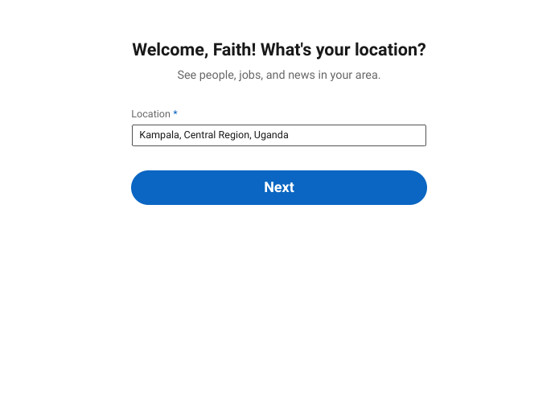

Slide 25
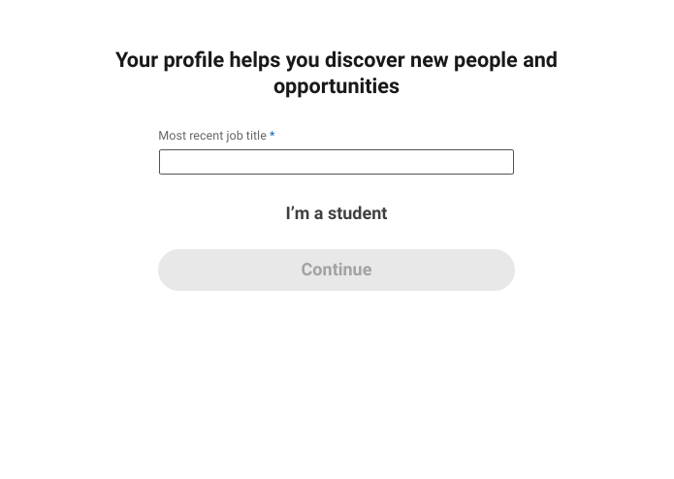

Slide 26
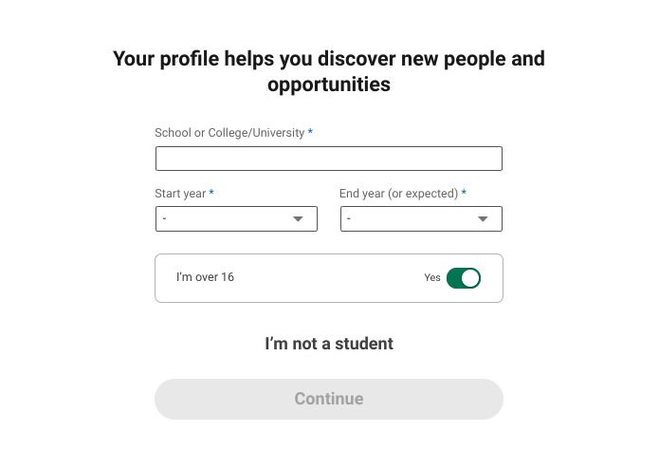

Slide 27
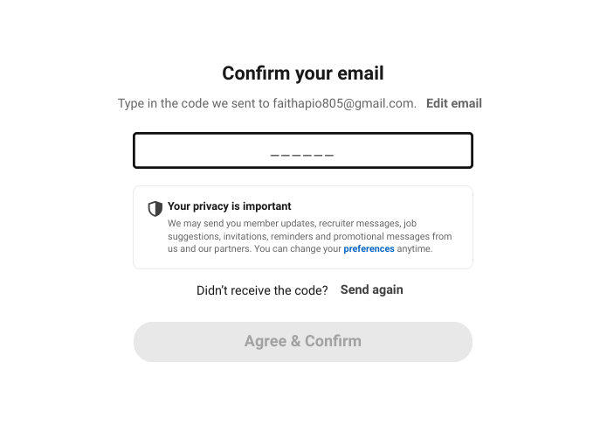

Slide 28
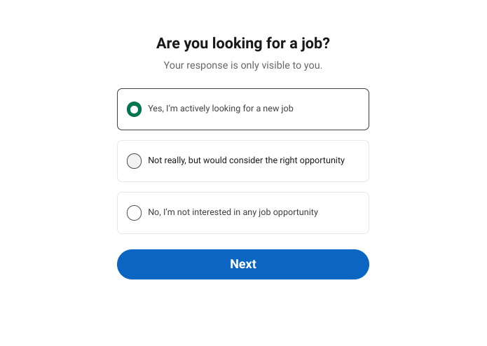

Slide 29
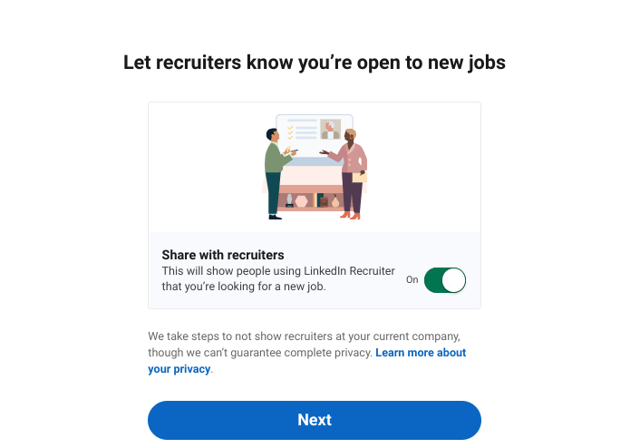

Slide 30
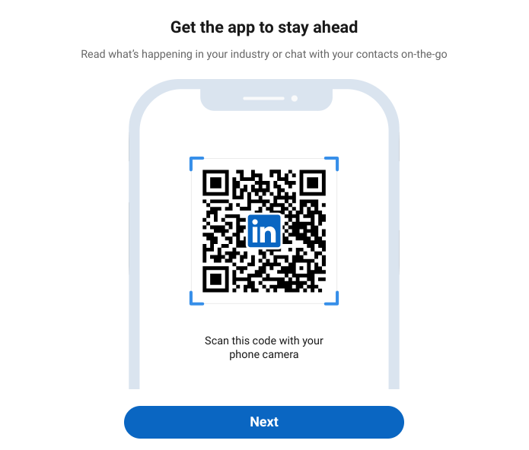

Slide 31
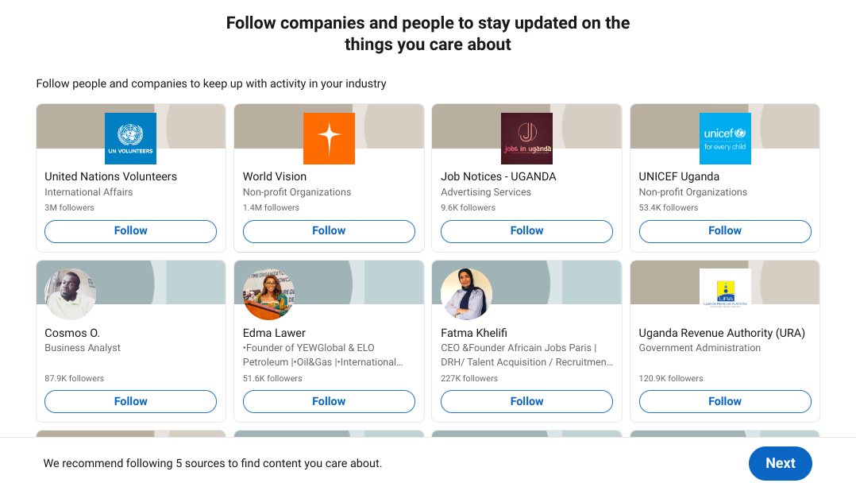

Slide 32
Conclusion: LinkedIn for Success
Networking
Build connections.
Job Search
Find opportunities.
Career Growth
Advance your career.

Slide 33

Thank you for listening.

